Slide 1
Employee Income Prediction App (SVM)
CAPSTONE PROJECT
Presented By:
Ritoban Datta -
SRM Engineering of science and technology Ramapuram,
Chennai

Slide 2
OUTLINE
Problem Statement System Development Approach
Algorithm & Deployment
Result
Conclusion
Future Scope
References

Slide 3
Problem Statement
In today’s data-driven world, organizations handle large amounts of employee information related to demographics, job roles, education, and work patterns. Understanding and predicting an employee’s income class based on these attributes can aid in better workforce planning, talent acquisition, and compensation structuring. However, manually analyzing such data is time-consuming and prone to bias or inaccuracy. There is a need for an intelligent system that can automate this process and deliver consistent predictions. The goal is to build a machine learning model that can accurately classify whether an employee earns more than ₹50K or not based on structured input data.

Slide 4
System Approach
The system was developed using the following technologies and tools:
Language: Python
IDE: Jupyter Notebook, Visual Studio Code
Libraries:
pandas, numpy – for data manipulation
matplotlib, seaborn – for data visualization
scikit-learn – for model training (SVM, Random Forest, Logistic Regression)
joblib – for saving the model
streamlit – for frontend deployment as a web application
Deployment: Localhost using Streamlit server

Slide 5
Algorithm & Deployment
1.Data Loading:
Load Data.csv using pandas.
2.Preprocessing:
Replace all unknown values (?) with NaN.
Drop rows containing missing values.
Drop irrelevant features like fnlwgt.
3.Encoding:
Apply LabelEncoder to categorical features (e.g., gender, education).
4.Feature Selection:
Select input features such as age, education, occupation, workclass, capital-gain, etc.
Target variable: income (encoded as binary).

Slide 6
Algorithm & Deployment
5.Splitting:
Split the dataset into training and testing sets (80:20 ratio).
6.Model Training & Comparison:
Train and evaluate Logistic Regression, Random Forest, and Support Vector Machine (SVM).
Use a pipeline with StandardScaler for normalization.
7.Model Evaluation:
Compare models based on accuracy.
SVM gave the highest accuracy (~85.59%).
8.Model Saving:
Save the trained SVM model and label encoders using joblib

Slide 7
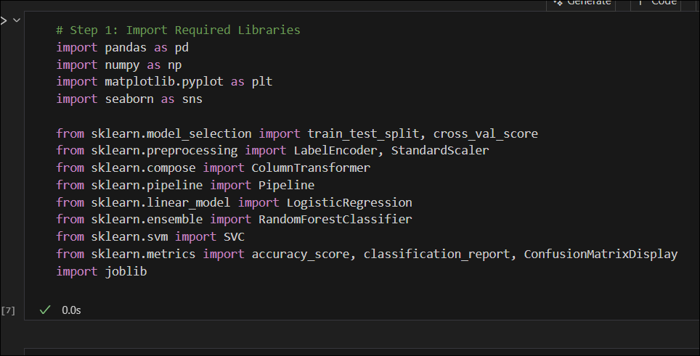
Result

Slide 8
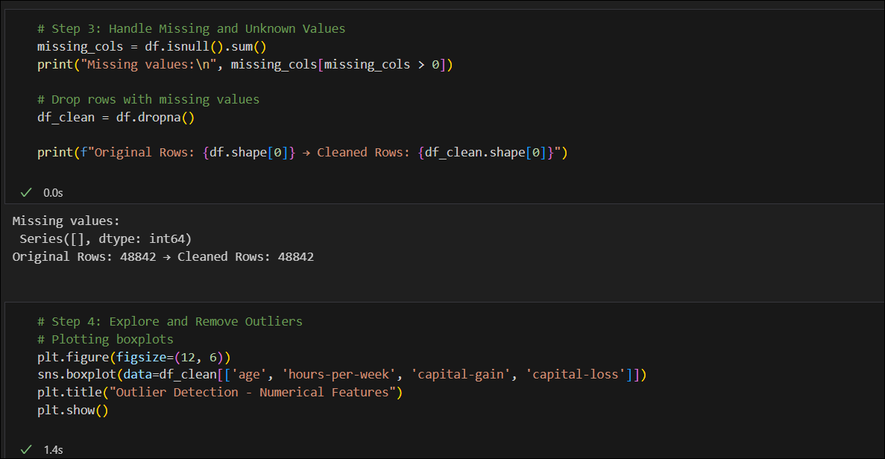
Result

Slide 9
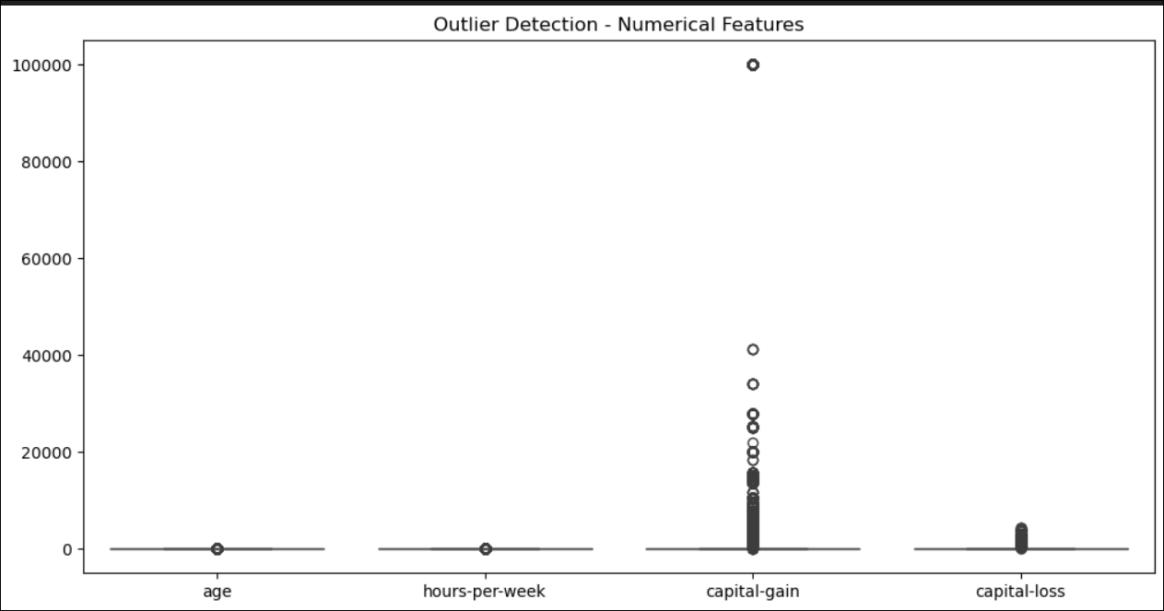
Result

Slide 10
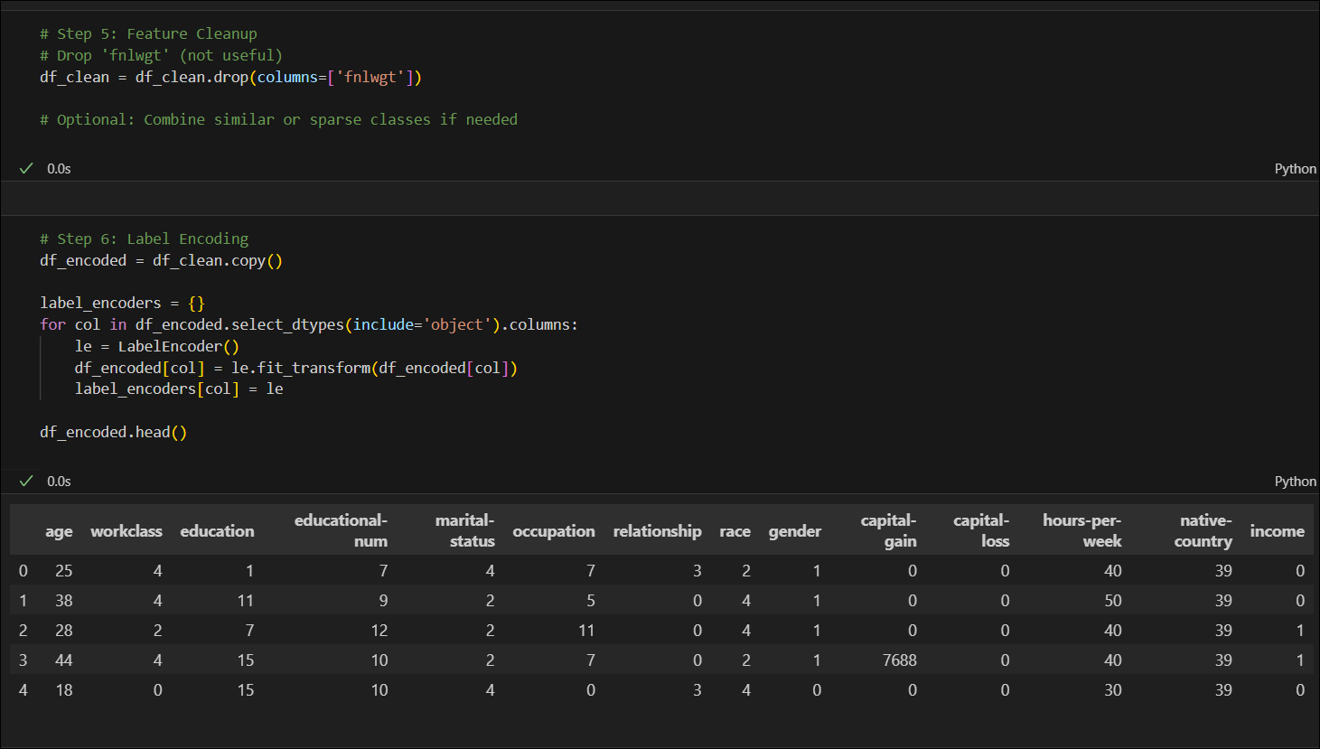
Result

Slide 11
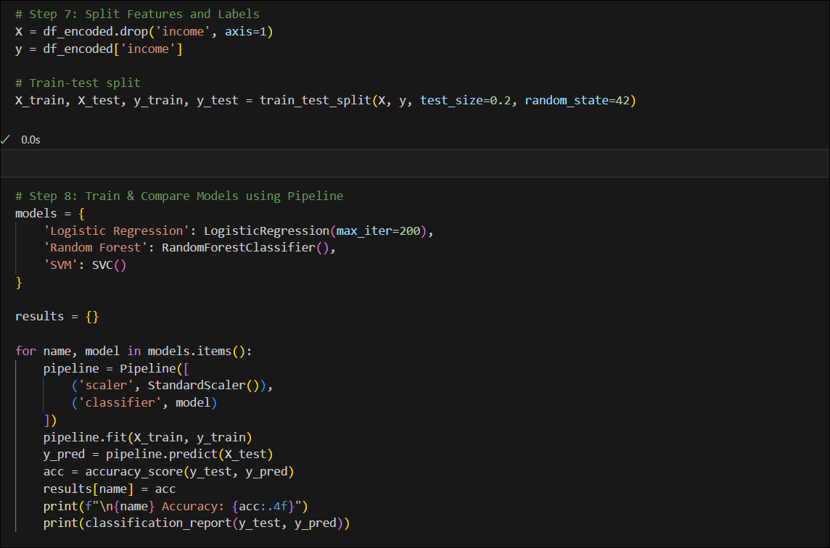
Result

Slide 12
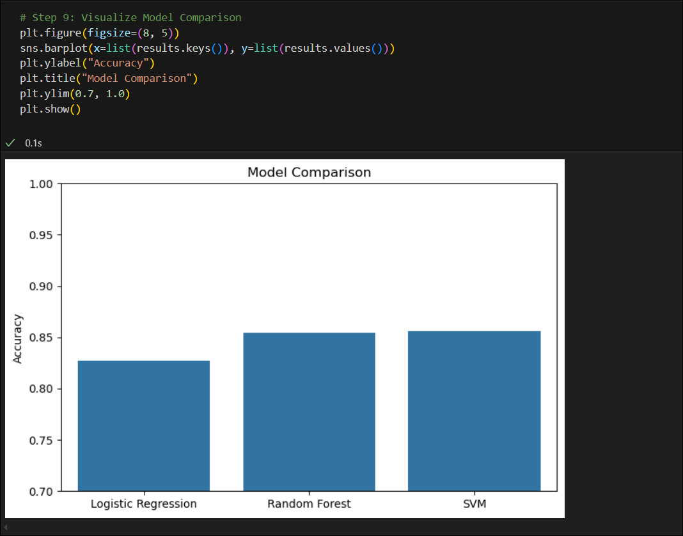
Result

Slide 13
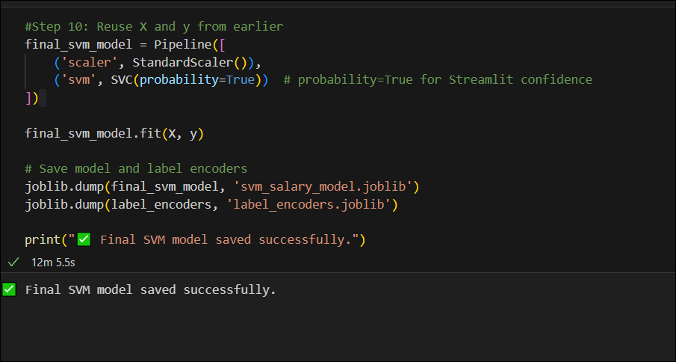
Result

Slide 14
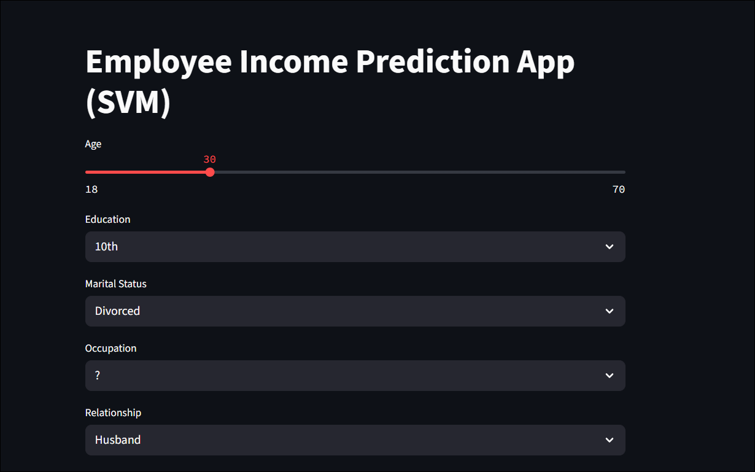
Result - Output

Slide 15
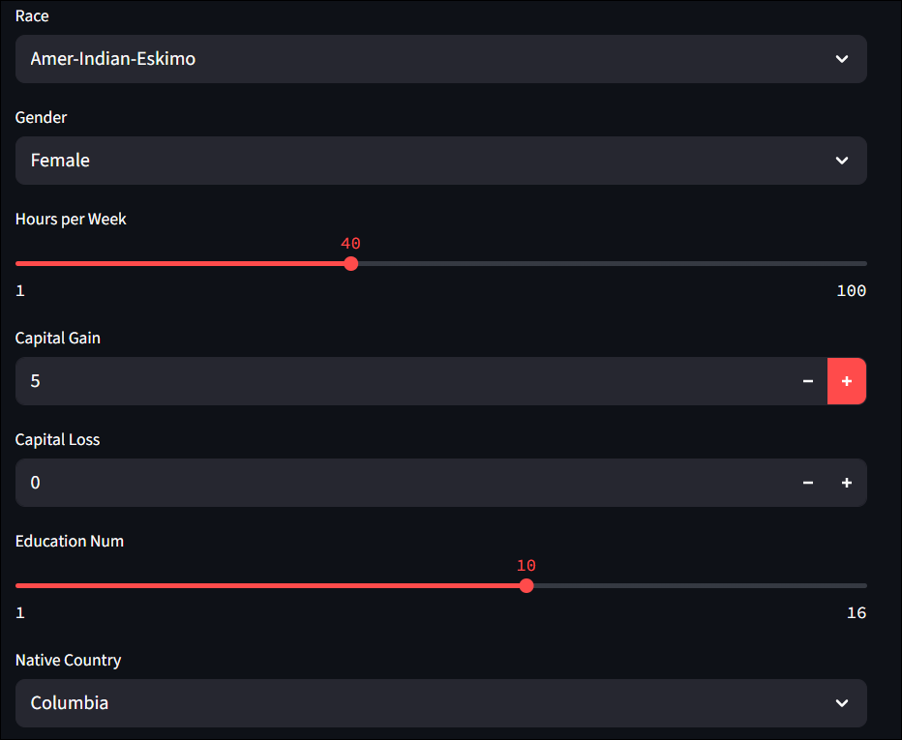
Result - Output

Slide 16
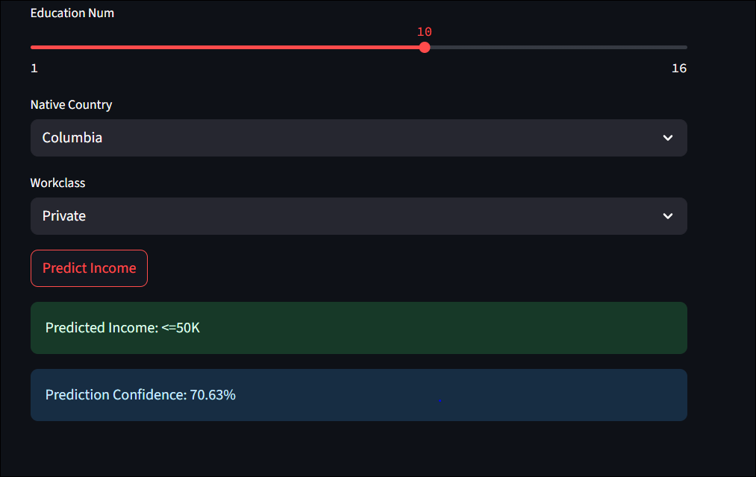
Result - Output

Slide 17
Result - Output
Attach your Github link
https://github.com/ribobun/Employee-Salary-prediction-model.git

Slide 18
Conclusion
The employee salary prediction system developed using Support Vector Machine (SVM) proved to be highly effective, achieving an accuracy of 85.59%, outperforming other models like Logistic Regression and Random Forest. The system was successfully deployed using Streamlit, allowing for an interactive and user-friendly interface where users can input relevant employee details to get real-time salary class predictions (>50K or <=50K).
Effectiveness of the Solution:
SVM performed best due to its capability to handle high-dimensional and non-linear relationships in the dataset.
The model generalized well to unseen data, as seen from consistent accuracy across training and testing splits.
The combination of preprocessing, label encoding, and feature scaling significantly enhanced model performance.

Slide 19
Conclusion
Challenges Encountered:
The dataset contained missing or ambiguous values (?), especially in columns like workclass, occupation, and native-country, which required careful preprocessing.
Label encoding of multiple categorical variables while maintaining mapping for prediction was complex and required saving encoders.
Model deployment required reshaping the user input format exactly to match the trained data pipeline, which took multiple iterations to align.
Potential Improvements:
Implementing advanced techniques like one-hot encoding with sparse matrices or tree-based embedding for better categorical handling.
Incorporating additional features such as company size, job title, or performance ratings to improve accuracy.

Slide 20
Future scope
Real-Time Integration with HRMS Tools: The model can be integrated with Human Resource Management Systems (HRMS) to offer dynamic salary forecasting, performance-based compensation modeling, and hiring recommendations.
Model Explainability and Bias Detection: Future versions can incorporate explainable AI techniques like SHAP (SHapley Additive exPlanations) or LIME to make model decisions more transparent and understandable to HR professionals. This will also help in identifying and mitigating any biases in the model.
Improved Data Enrichment: Including additional features such as educational background, skill sets, certifications, job performance metrics, and market trends can improve the prediction accuracy and provide deeper insights.
Multiclass Salary Prediction: Instead of classifying salaries into binary classes (>50K or <=50K), the model can be extended to predict salary ranges (e.g., 30K-40K, 40K-60K, etc.) using regression or multiclass classification techniques.

Slide 21
References
Dua, D. and Graff, C. (2019). UCI Machine Learning Repository: Adult Income Dataset. Irvine, CA: University of California, School of Information and Computer Science.https://archive.ics.uci.edu/ml/datasets/adult
Scikit-learn: Machine Learning in Python. Pedregosa et al., Journal of Machine Learning Research, 2011.https://scikit-learn.org
Streamlit Documentation – The fastest way to build and share data apps.https://docs.streamlit.io
Python Data Science Handbook by Jake VanderPlas – O’Reilly Media, 2016.
Géron, A. (2019). Hands-On Machine Learning with Scikit-Learn, Keras, and TensorFlow. 2nd Edition. O’Reilly Media.

Slide 22
THANK YOU

